Slide 1



Retinal Image Analysis for multi-Disease Detection Challenge
Team：WWW
Member
Chia-Yen Lee
Hung Yeh
Kai-Wen Cheng

Slide 2
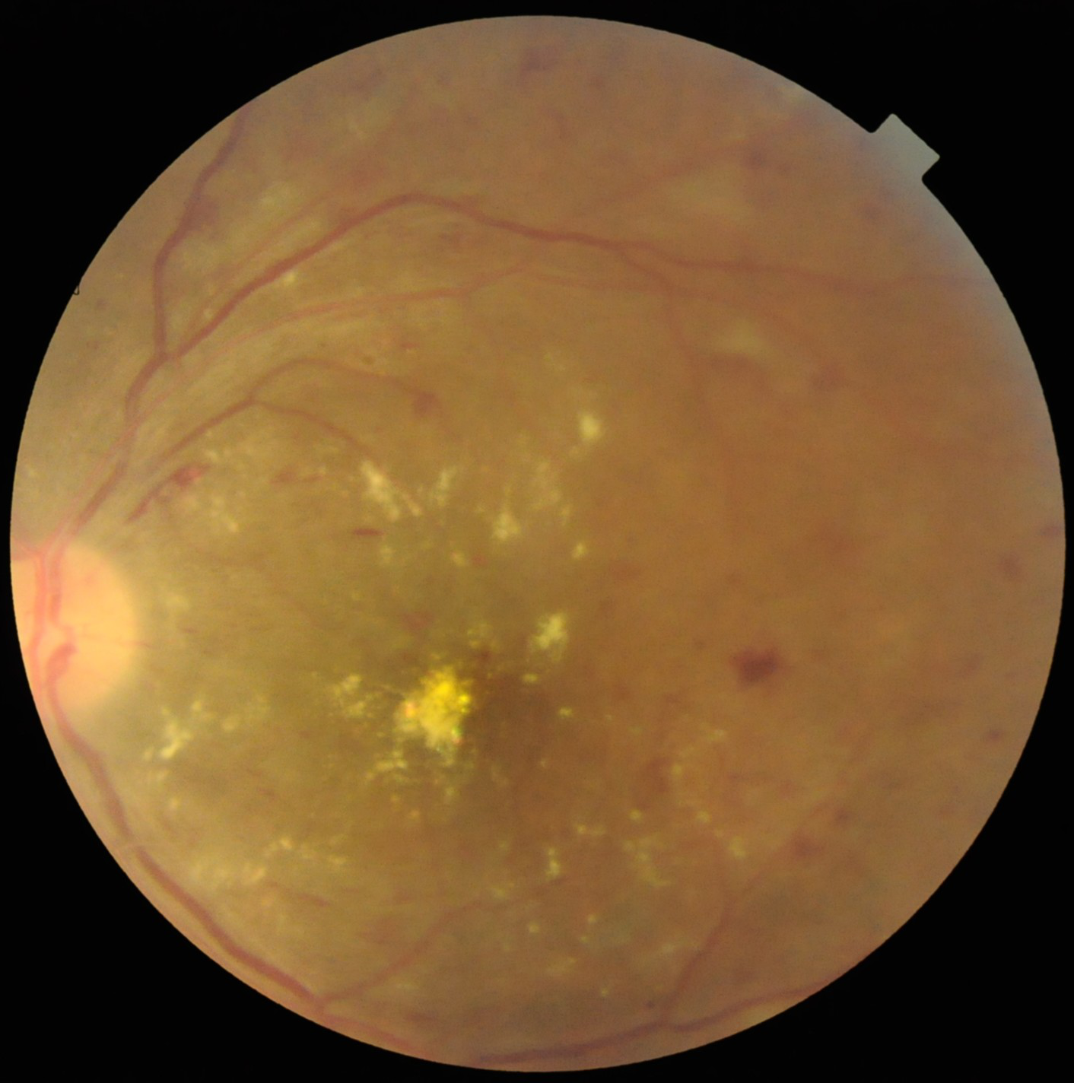
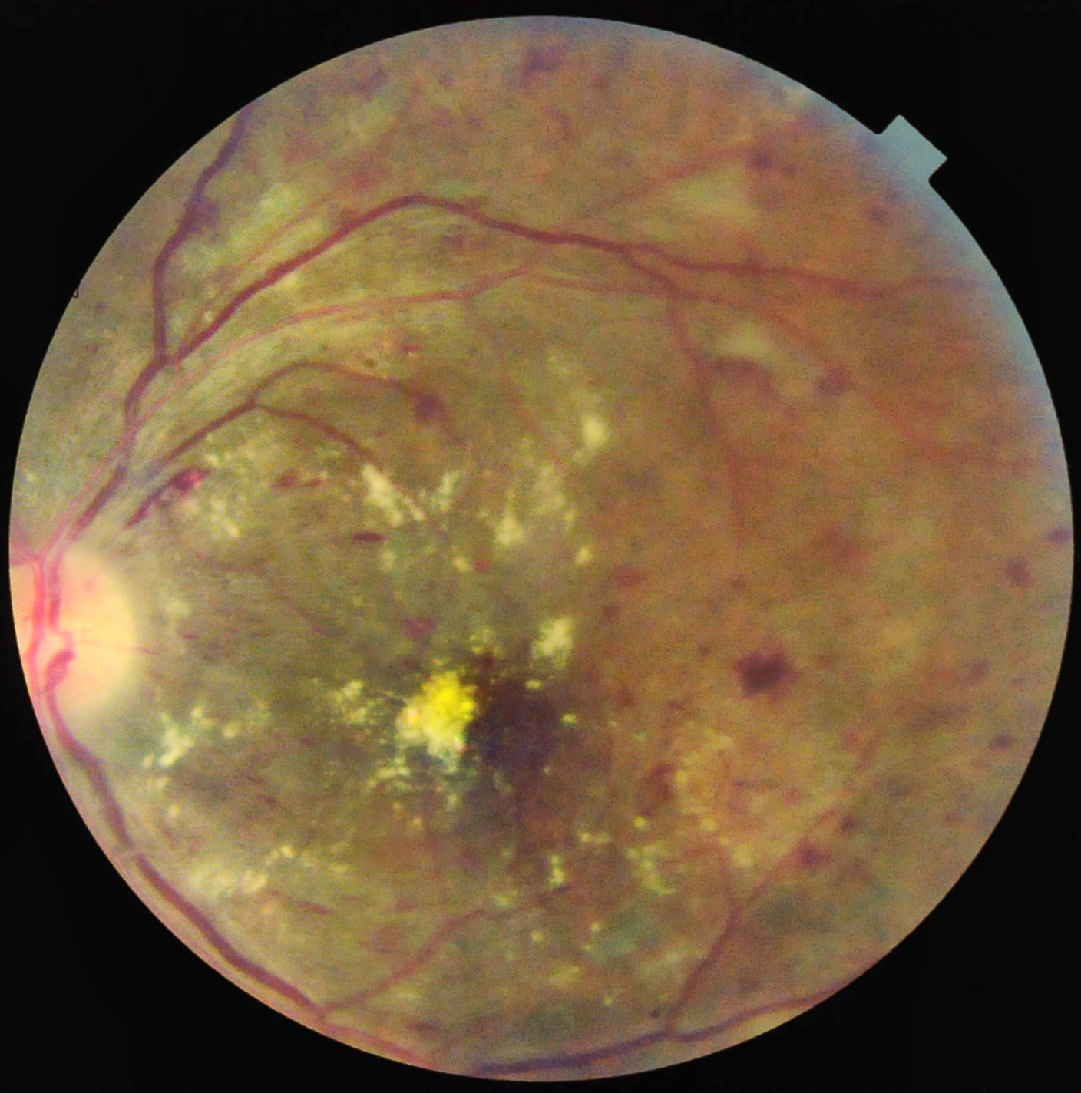
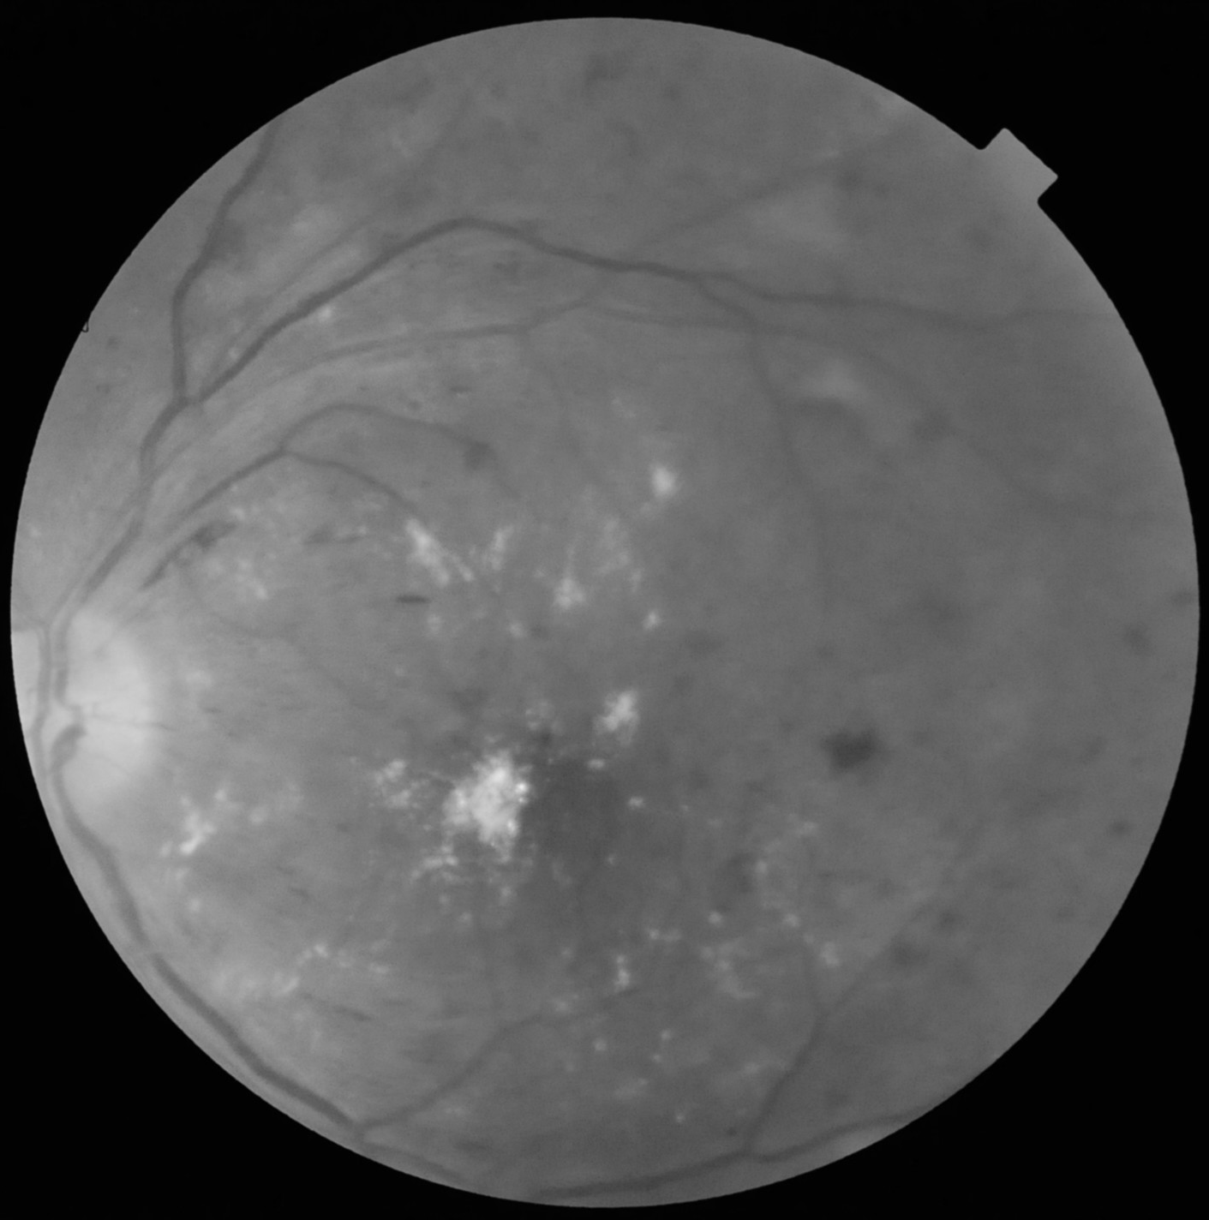
Pre-processing
Original image：
CLAHE image：
Green Channel image：

Slide 3
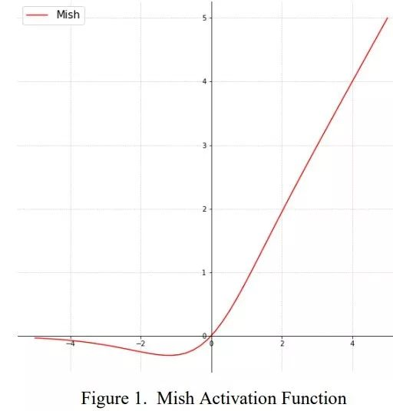
Replace adam with ranger
Activation Function & Optimizer
Mish activation function：
Optimizer：
Replace Adam with ranger
[1] https://zhuanlan.zhihu.com/p/84418420

Slide 4
Task1

Slide 5
Process
EfficientNet B3-B7
(Original image)
Soft voting
EfficientNet B7
(CLAHE image)
Final Result
EfficientNet B7
(Green Channel image)

Slide 6
Task2

Slide 7
Process
EfficientNet B3-B8
(Original image)
EfficientNet B7
(CLAHE image)
Soft voting
Final Result
EfficientNet B7
(Green Channel image)
TResNet
(Original image)

Slide 8
Loss
Asymmetric Loss

Slide 9
Thanks for attention

